Slide 1
The Problem with Passwords -- Humans
HashiCorp Vault - Dynamic Passwords
John Dohoney, Jr.
September 7, 2018

Slide 2
Agenda
Who am I
Overview -- Passwords as a Security Problem
Solution - Secrets Management and HashiCorp Vault
How we stack up to alternatives
Questions

Slide 3

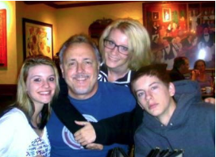

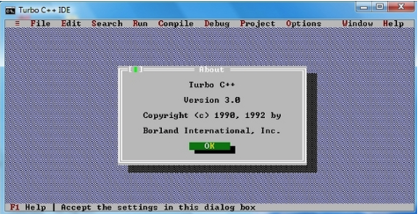



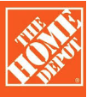





Who am I
Professionally
Home

Slide 4
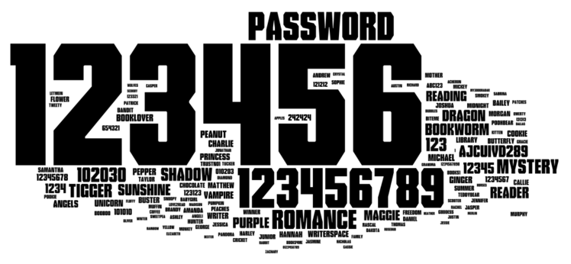
How original

Slide 5

Add Password Policies = Post-It Notes

Slide 6
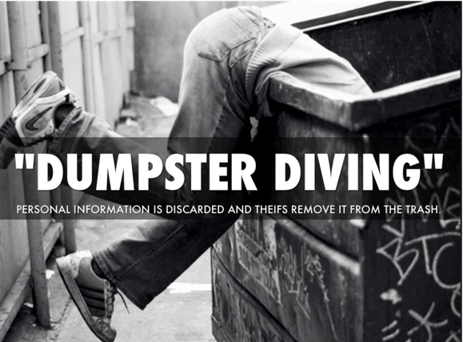
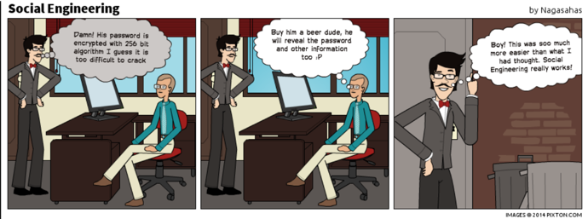
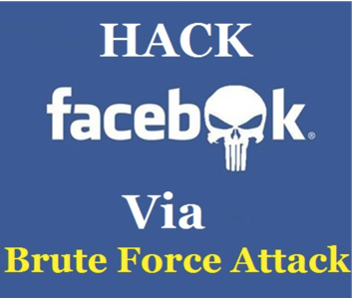
Bad Stuff Starts to happen...

Slide 7
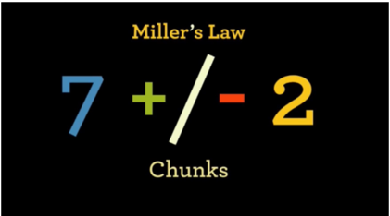
Cognitive Science has an explanation
Our brain is a machine that recognize patterns, chunk things together & then process the chunks to gain understanding. According to Miller, our minds can easily process somewhere between 5-9 chunks of information at any given time. Any more than that and our brains are overloaded. Think about your passwords...

Slide 8
For evil to prevail, good men need do nothing
Gentoo Hack (June 2018) - https://www.networkworld.com/article/3287973/linux/the-aftermath-of-the-gentoo-github-hack.html
“The most obvious take-home was that the admin's password was guessed because it too closely related to one that had been captured on another system. This might be like your using "Spring2018" on one system and "Summer2018" on another.”
Tweeter Hack (May 2018) - https://blog.twitter.com/official/en_us/topics/company/2018/keeping-your-account-secure.html
“Due to a bug, passwords were written to an internal log before completing the hashing process. We found this error ourselves, removed the passwords, and are implementing plans to prevent this bug from happening again.”
Github (May 2018) - https://www.bleepingcomputer.com/news/security/github-accidentally-recorded-some-plaintext-passwords-in-its-internal-logs/
GitHub says that normally, passwords are secure, as they are hashed with the bcrypt algorithm. The company blamed a bug for plaintext passwords ending up in its internal logs. Only users who've recently reset passwords were affected.

Slide 9
Solution: Secrets Management Approach
Managing a set of different credentials, both Authorization (AuthZ) and Authentication (AUTHN) in nature that includes:
DB Credentials
API Token
TLS Certificates
Username and Password
The result of not managing these are what is called “Secret Prawl” - the AUTHN and AUTHZ data is everywhere in the enterprise. Compounding, this are the questions of who is authorized to see this information, and if they did, how could we audit this access? Furthermore, most secret management approaches are usually static, not rotated, and not given an expiration on usage.

Slide 10
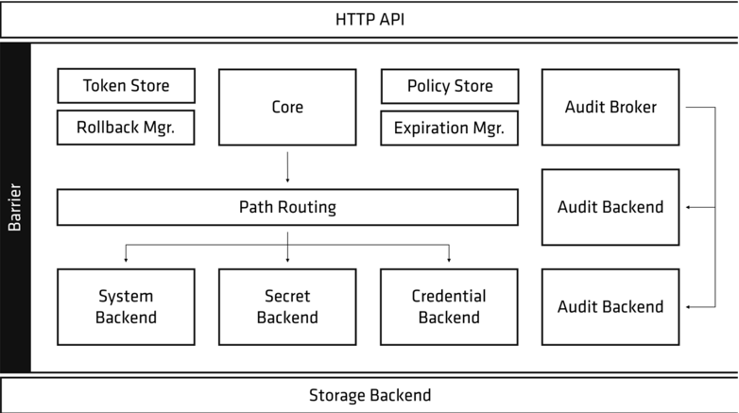
Design Pattern for Secret Sprawl Remediation
Centralizes access
Heavy Use of Encryption
Encrypted at rest
Encrypted in transit
Inside the system.
Specific Access
fine grained role based access
Auditable
Not only who, but what credential and the outcome of access request

Slide 11
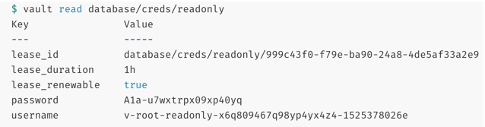
The need for Ephemeral Secrets
Why?
Traditional Hard coding of config files with passwords
Today, Kubernetes and Marathon -- DC/OS only uses Static secrets; K8 has a Vault Operator by CoreOS
Logs out to STDOUT -- See Slide 8 - Tweeter Hack (May 2018)
Exceptions spit out “secret” information to monitoring system
Bounded credentials, reduces Attack Surface area, even if they do leak, usage is limited - “Moving Target”
Credentials are unique to a client, and easier to isolate due to unique credentials
Easier Revocation and isolates a leak

Slide 12
Application Storage
Cryptography is hard to implement properly - if you need it, it will also get audited
Creates Named Keys -- examples: PII, SSN, Credit Cards
HIgh Level API’s -- Encrypt, Decrypt, Sign, Verify as example
Hides actual implementation (Information Hiding) example: HMAC256, SHA512
Offloads Key Management -- Key Creation, Key Versioning, Key Rotation, and Key Decommissioning - jast hard to do properly

Slide 13
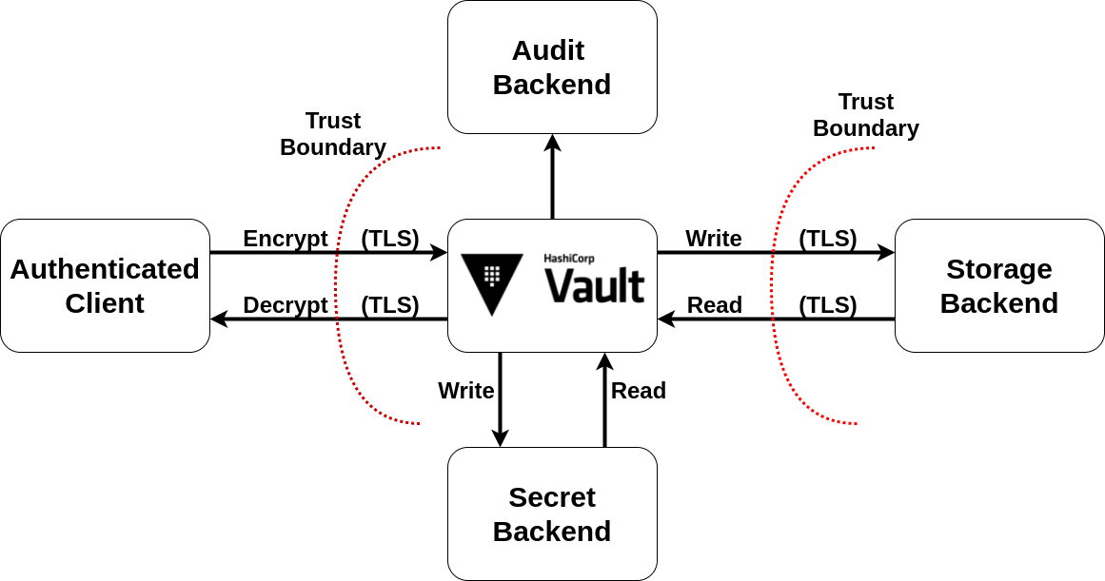
Solution: Hashicorp Vault
Secret Store
Dynamic Secrets
Encryption as a Service
Secrets Audit Trail

Slide 14
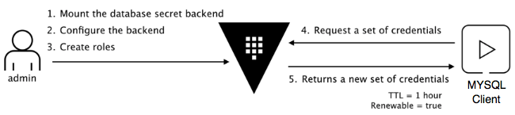
Dynamic Secrets Demo

Slide 15
Are there Choices?
HSM - hardware Security Module -- wins the war in Complexity and Cost, seems to be advantageous when there is a FIPS compliance requirement. Vault does complement an HSM, for example, adds Dynamic Secrets capability.
Chef and Puppet -- Weak, one password away from being decrypted. TIed to the respective system, Vault has no vendor lock-in. CHef’s data bag and Puppets” Heira area feel good product, no dynamic secrets, No secrets as a service, and no RBAC
AWS KMS -- The AWS KMS is back by HSM. AWS KMS is solid for encryption key management as well as supporting Crypto-Ops and is FIPS 140-2 compliant. Vault is superior in that it handles any type of secret data, including database credentials, API keys, PKI keys, and encryption keys. Vault also supports dynamic secrets, generating credentials on-demand for fine-grained security controls, auditing, and non-repudiation. Vault is your best option for Multi-Cloud and Hybrid Cloud Ops.

Slide 16
Are there Choices continued?
Azure and GCE -- Upgrade to Enterprise Pro, both are supported. Enterprise Pro is your best dollar, for multi-cloud and avoiding platform lock-in. Both have a KMS, Azure Key Vault went head to head with Amazon is FIPS 140-2 level 2 compliant backed by HSMs. Google CLoud KMS is similar to both AWS and Azure, they up the ante on with FIPS 140-2 level 3 device compliance. As with AWS, Vault is superior in that it handles any type of secret data, including database credentials, API keys, PKI keys, and encryption keys. Vault also supports dynamic secrets, generating credentials on-demand for fine-grained security controls, auditing, and non-repudiation. Vault is your best option for Multi-Cloud and Hybrid Cloud Ops.
Keywhiz is a secret management solution built by Square. Vault and Keywhiz are on parity in many ways. Where vault is differentiated is how it forces a mandatory lease contract with clients. All secrets read from Vault have an associated lease which enables operators to audit key usage, perform key rolling, and ensure automatic revocation. Vault provides multiple revocation mechanisms to give operators a clear "break glass" procedure after a potential compromise.

Slide 17

Questions

